Slide 1

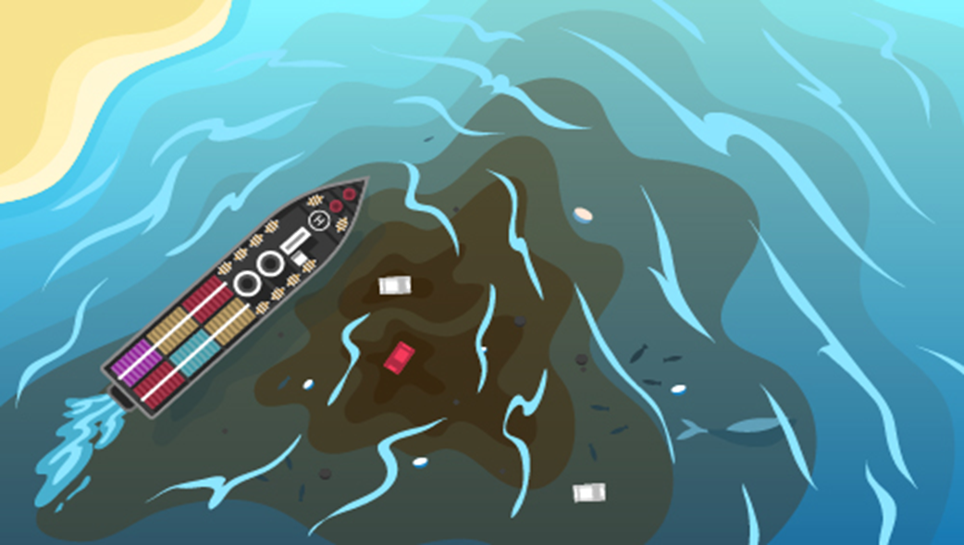

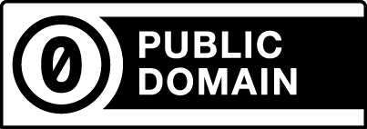
After Chemical Spill, Oil Spill Risk near Sri Lankan Beach
FlowerEconomics
com
MITIGATION STRATEGIES
Regulation: A cap on dollar amount of ecological damage, traded via instruments.
Economic: Tackling unemployment, so wages match qualification.
Education: Enabling rapid development of technology to neutralize oil and chemical particulate.
-- Mitigation Strategies, Copyright and related rights waived via CC0

